Slide 1

Estimating when four natural resources will be depleted
Capstone 3 – Springboard Data Science Track
By: Yvonne Quiachon, CPhT
Cleveland State University: Bachelor of Science in Biomedical Technology

Slide 2
Slideshow Timeline
Context
Data Acquisition
EDA: Coal
EDA: Oil
EDA: Natural Gas
Synthetic Control:Coal
Synthetic Control:Oil
Synthetic Control: Natural Gas
Well Log Analysis
Classification Models
Gradient Boost
Max Drawdown: Oil

Slide 3
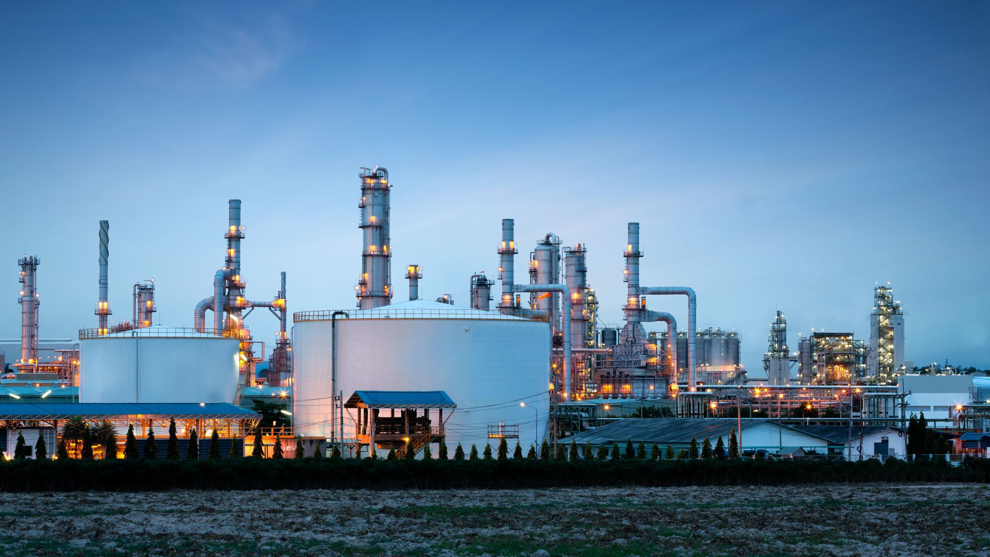
Context
Problems:
What possible effects (direct or indirect) does industrialization, modernization, and manufacturing have on the availability and distribution of coal, oil, and natural gas?
If and when will these resources be depleted?

Slide 4
Data Acquisition
Sources:
Global Power Plant Database - Datasets - Data | World Resources Institute (wri.org)
https://data.un.org/
Downloads | Energy economics | Home (bp.com)

Slide 5
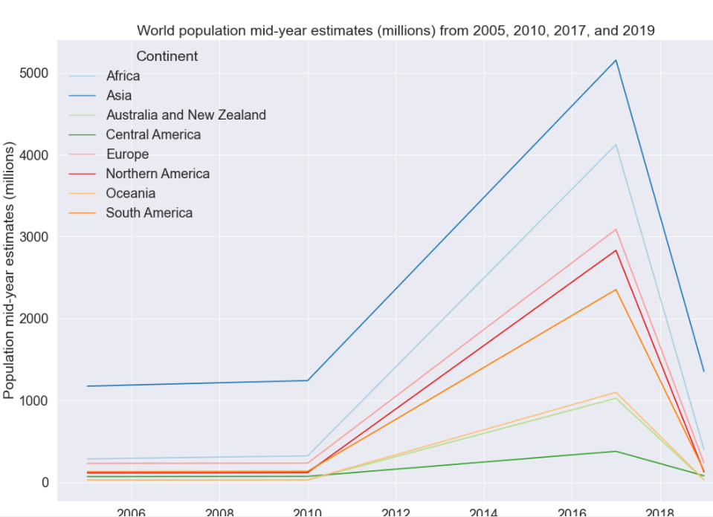
World-population mid-year estimates (millions) from 2005,201, 2017, and 2019
https://data.un.org/

Slide 6
Coal
Facts:
Cheap resource.
Surface mining or underground mining.
Provides steam and power needed to mass-produce items, generate electricity, generate heat, fuel steamships, fuel steel industry.
Emits CO2, SO2 (in U.S. generates 42% mercury emissions and 2/3 SO2 – contributing to acid rain and particulate matter).

Slide 7
EDA: Coal
Gwh for 2017
Top 6 Countries w/ highest est. gen. gwh for 2017: Taiwan, South Korea, South Africa, Malaysia, Israel, Mexico
Coal Reserves
Top 5 countries w/ most coal reserves: US, Russian Federation, Australia, China
Coal Production
China held top coal producer for 27 years. US is second.
Coal Consumption
China is 1st place, US 2nd place.

Slide 8
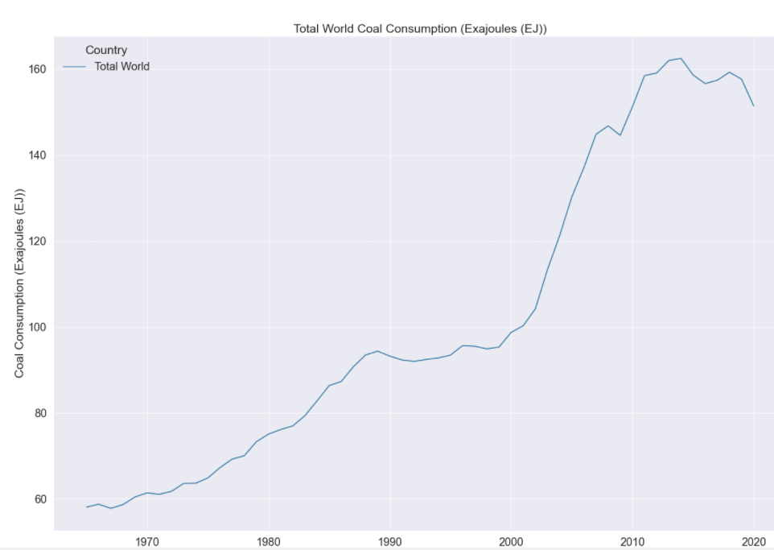
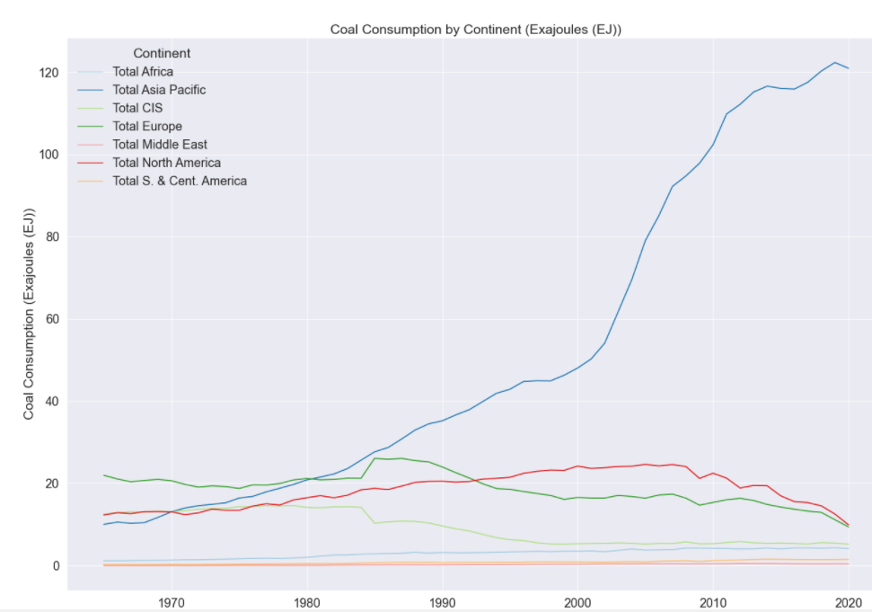
Coal Consumption: Total World and by Region

Slide 9
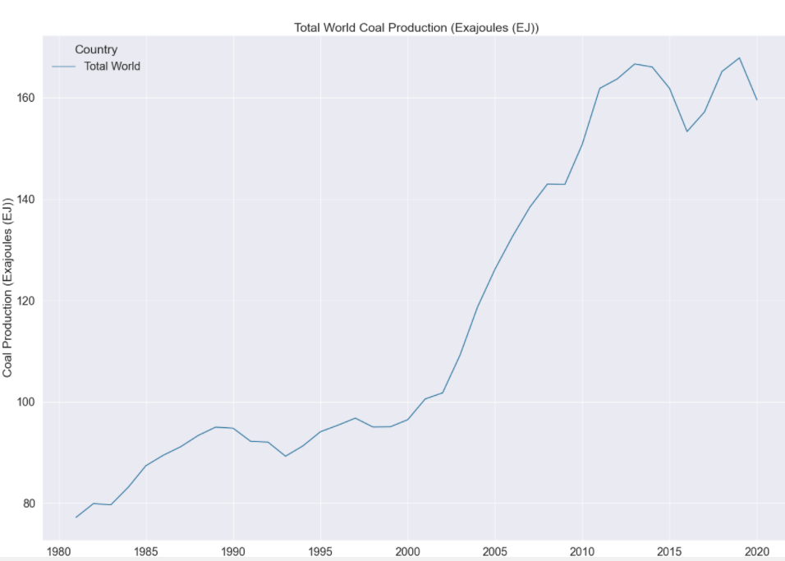
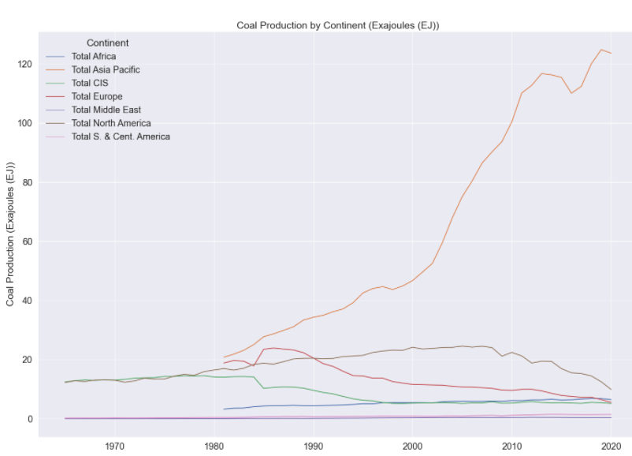
Coal Production: Total World and by Region

Slide 10
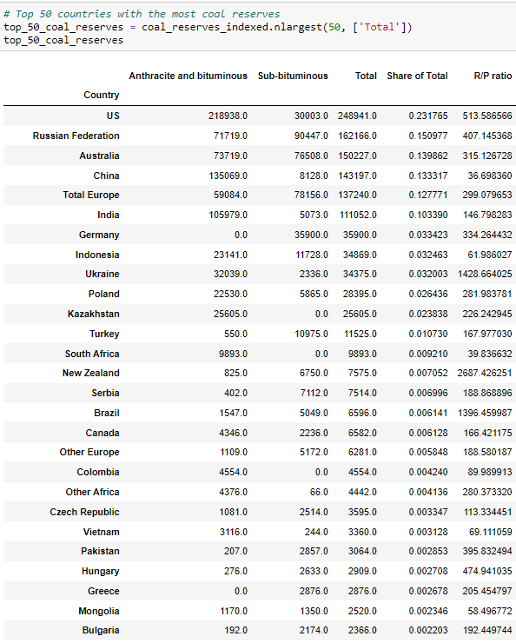
EDA: Coal Reserves

Slide 11
Oil
Facts:
If Asia were to catch up to U.S. diesel/oil consumption rates, the global production would 'have to rise by 300% per day'. It is because of diesel, fertilizer, and heavy equipment, farming yield rates increased 250% during the 1950s. Hence without oil, modern agriculture will not be able to feed the current world population. (Is The Earth Actually Running Out Of Oil? | The Struggle For Oil | Spark – YouTube)
A country with large amounts of reserves does not always translate to strong production numbers for petroleum, oil, and by-products. Oil reserves simply serve as an estimate of the amount of economically recoverable crude oil in a particular region. To qualify, these reserves must have the potential of being extracted under current technological constraints.

Slide 12
EDA: Oil
Capactiy MW
Top 6 Countries w/ highest capacity energy: Azerbaijan, Taiwan, Japan, South Korea, Singapore
Oil Reserves
Top 5 countries w/ most oil reserves at end of 2020: Venezuela, Saudi Arabia, Canada, Iran, Iraq
Oil Production
US leads in oil production. Saudi Arabia in 2nd place and Russian Federation in 3rd place (along with former USSR)
Oil Consumption
US is 1st place, Total Europe in 2nd place.

Slide 13
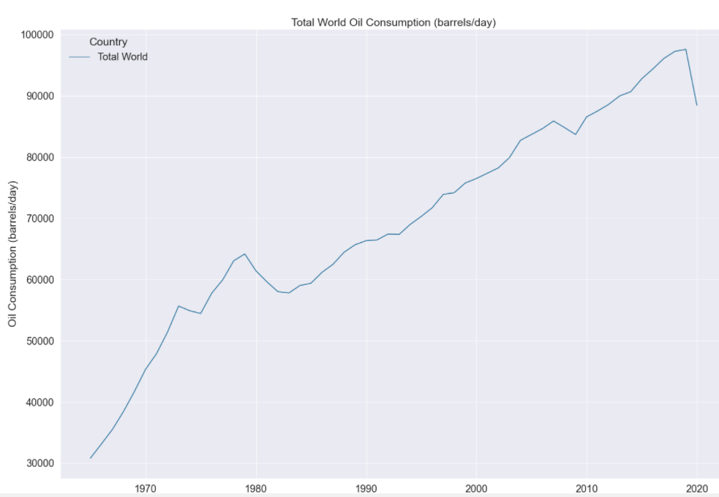
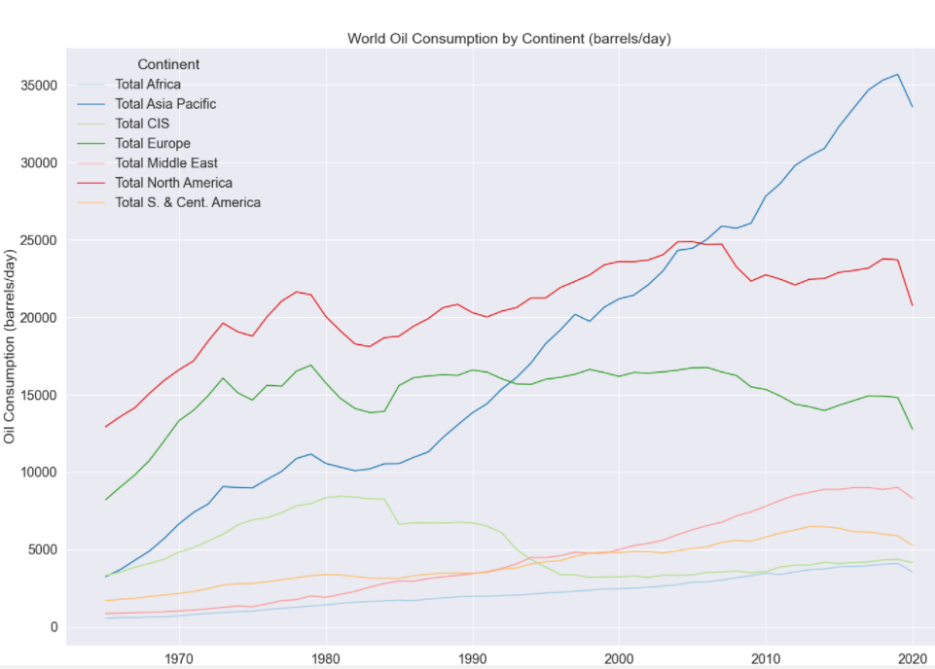
Oil Consumption: Total World and by Region

Slide 14
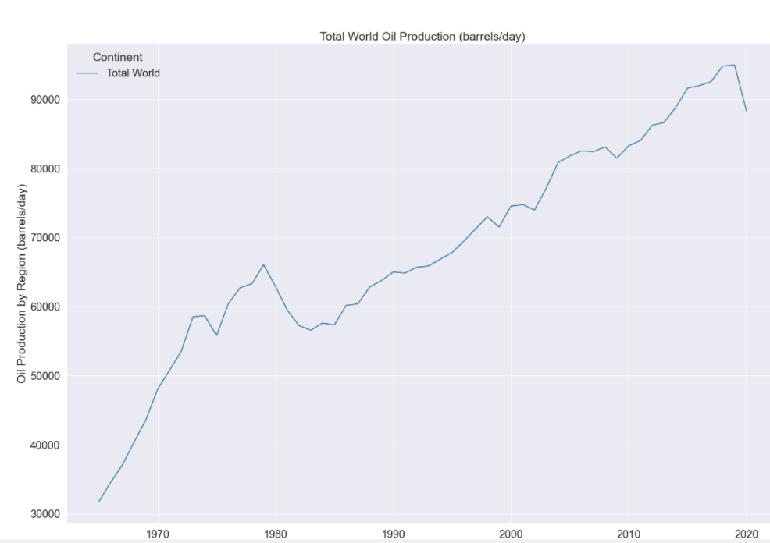
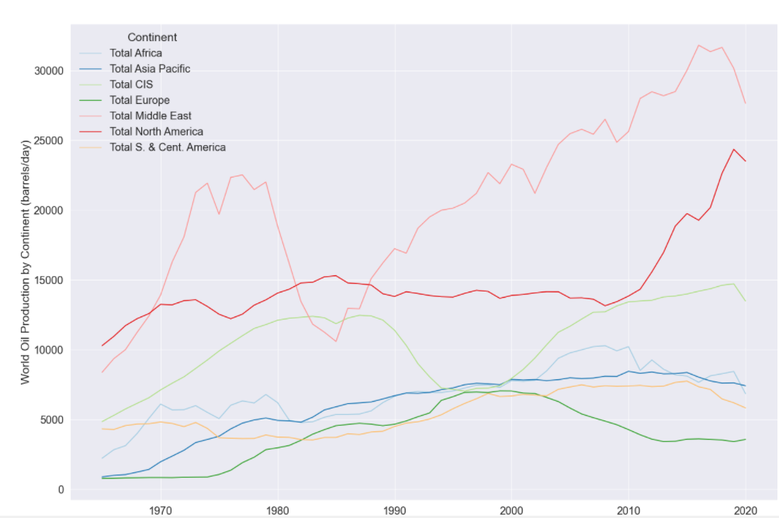
Oil Production: Total World and by Region

Slide 15
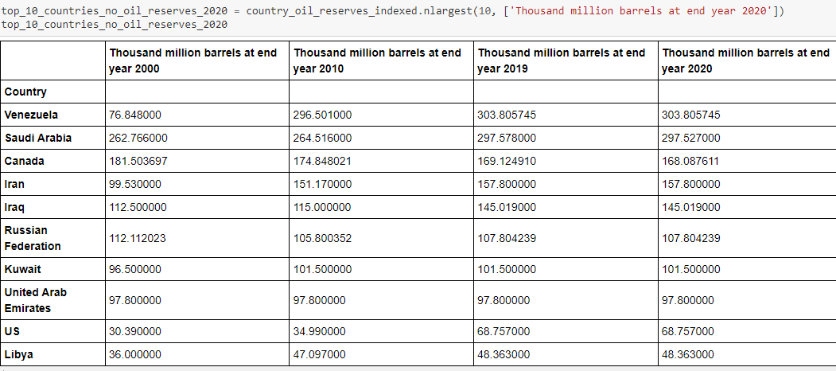
EDA: Oil Proved Reserves

Slide 16
EDA: Natural Gas
Capactiy MW
Top 6 Countries w/ highest capacity energy: Yemen, Vietnam, Venezeual, Uzbekiastan, U.S.
Gas Reserves
Top 5 countries w/ most oil reserves at end of 2020: Russian Federation, Iran, Qatar, Turkmenistan, U.S.
Gas Production
US leads in gas production. Russian Federation in 2nd place.
Gas Consumption
US is 1st place, Russian Federation in 2nd place.

Slide 17
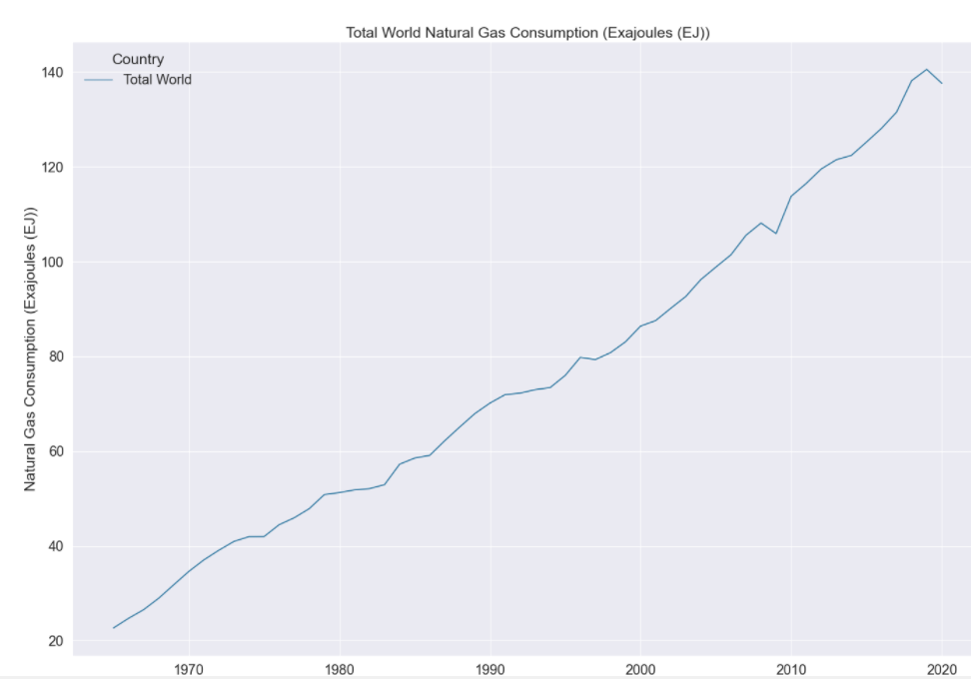
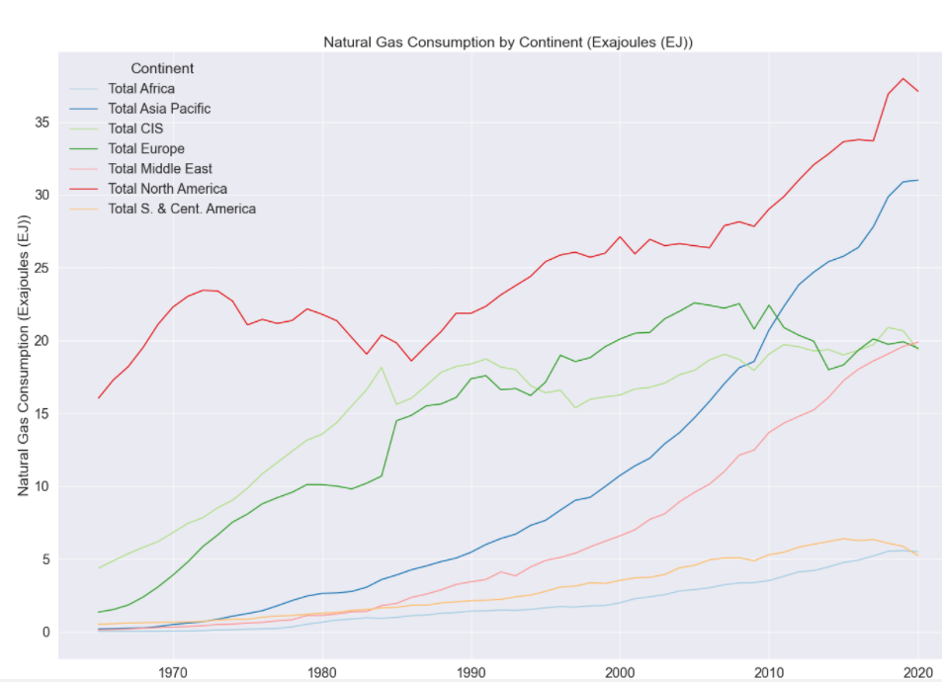
Gas Consumption: Total World and by Region

Slide 18
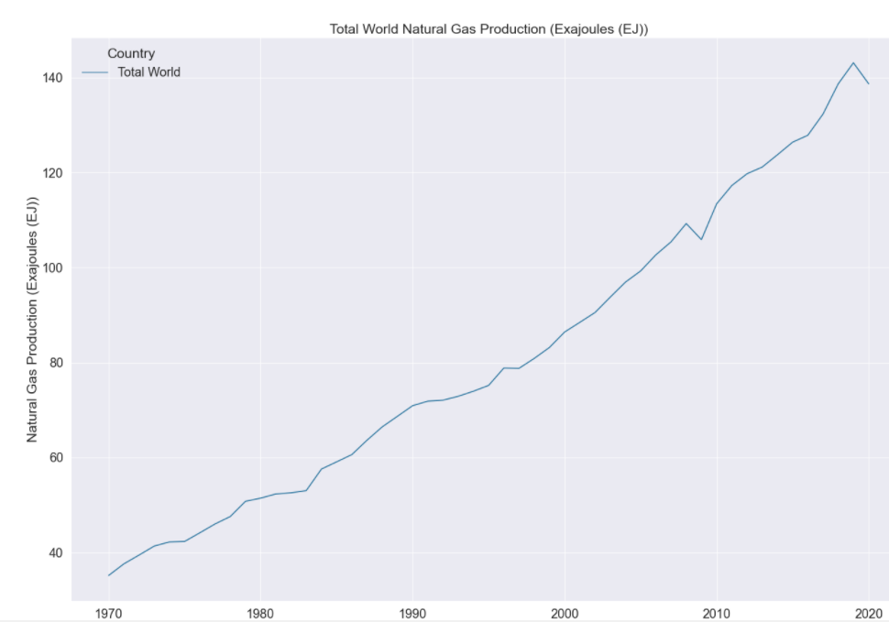
Gas Production: Total World

Slide 19
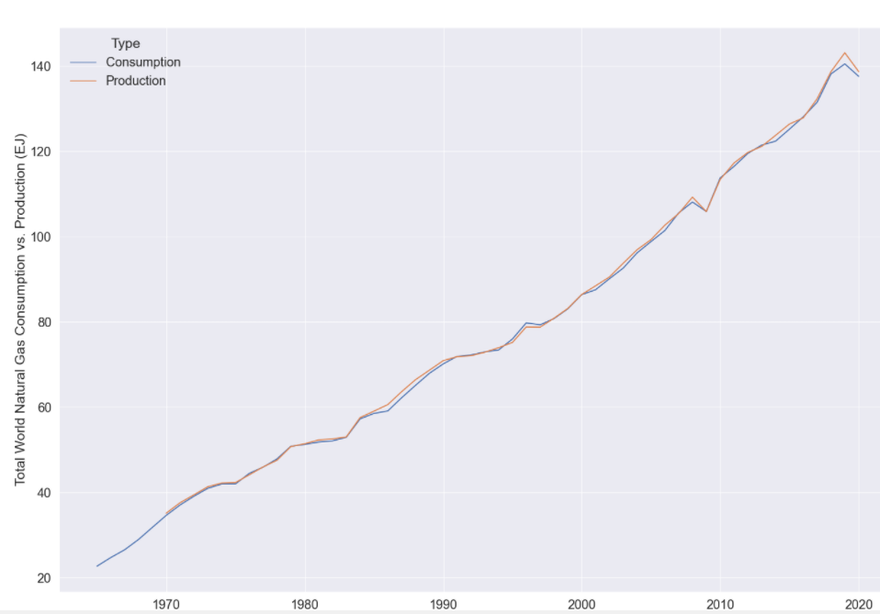
Gas: Total World Consumption vs. Production

Slide 20
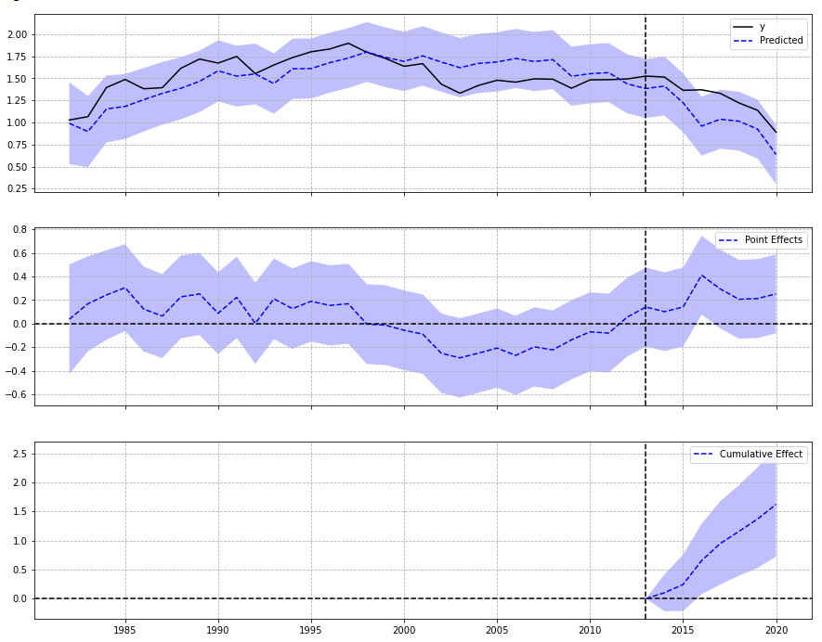
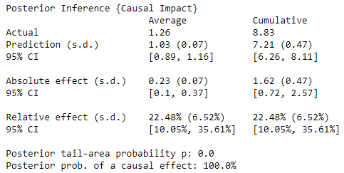
Synthetic Control: Coal Production
U.S.
Pre-period: 1981-2013 (83%)
Post-period: 2014-2020 (17%)

Slide 21
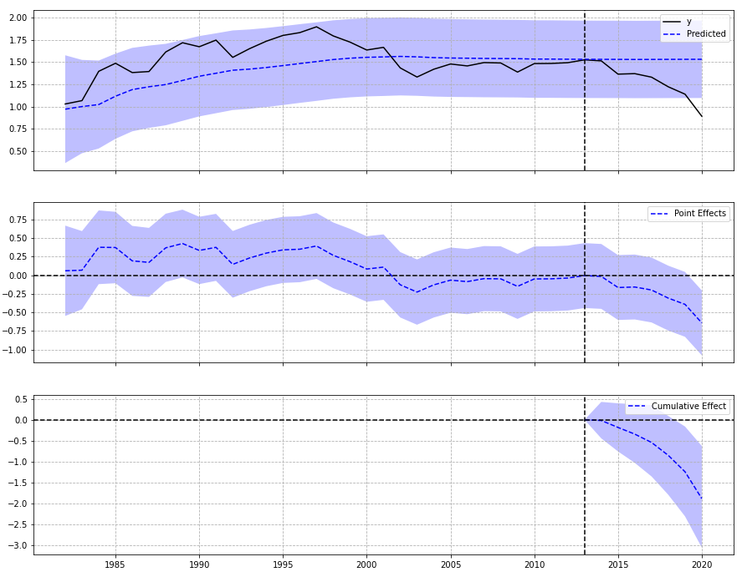
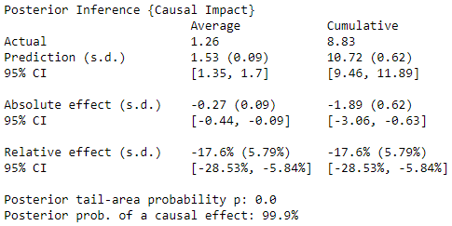
Synthetic Control: Coal Production
China
Pre-period: 1981-2013 (83%)
Post-period: 2014-2020 (17%)

Slide 22
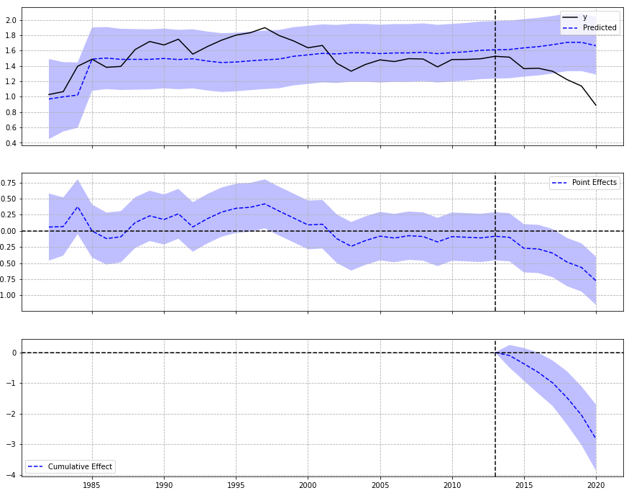
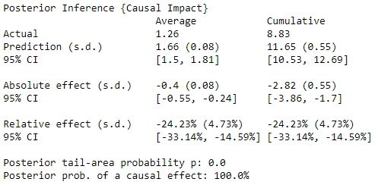
Synthetic Control: Coal Production
Russian Federation
Pre-period: 1981-2013 (83%)
Post-period: 2014-2020 (17%)

Slide 23
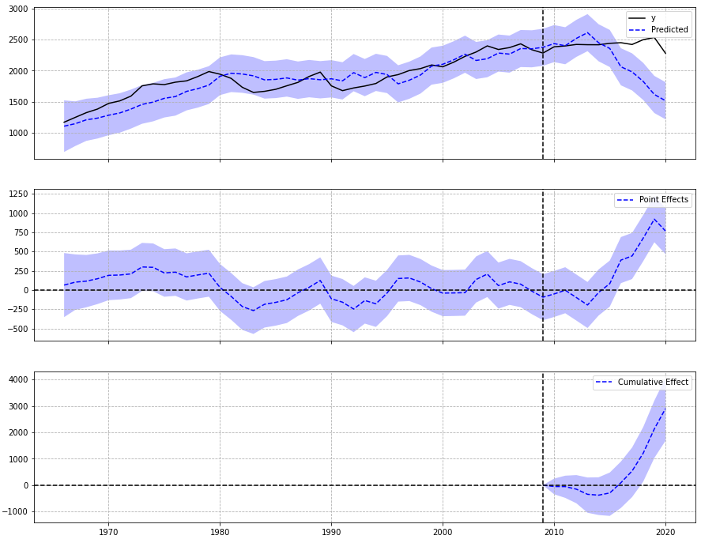
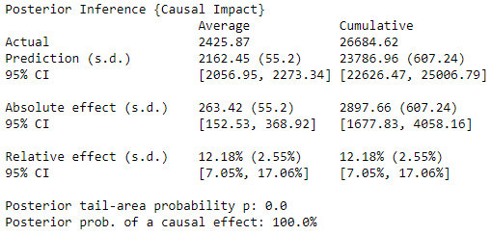
Synthetic Control: Oil Consumption
Venezuela
Pre-period: 1965-2009 (80%)
Post-period: 2010-2020 (20%)

Slide 24
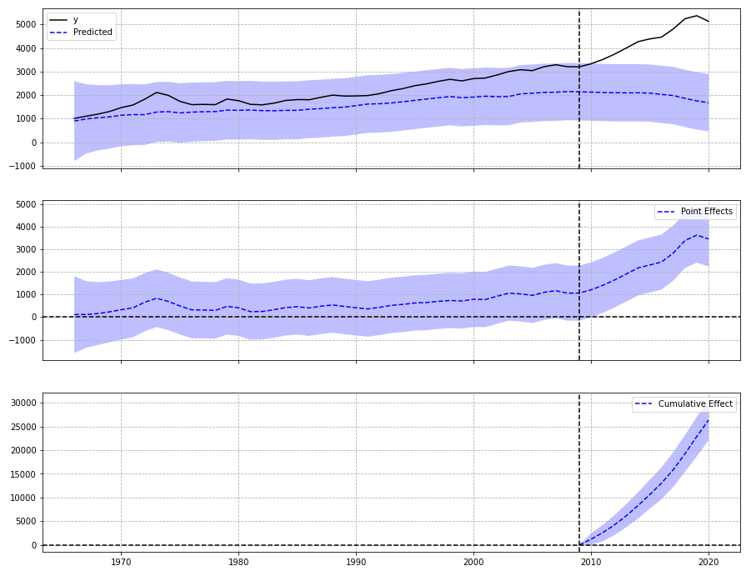
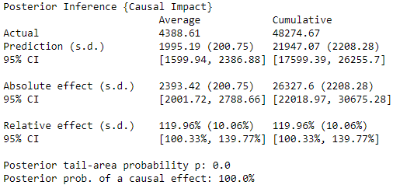
Synthetic Control: Oil Production
Venezuela
Pre-period: 1965-2009 (80%)
Post-period: 2010-2020 (20%)

Slide 25
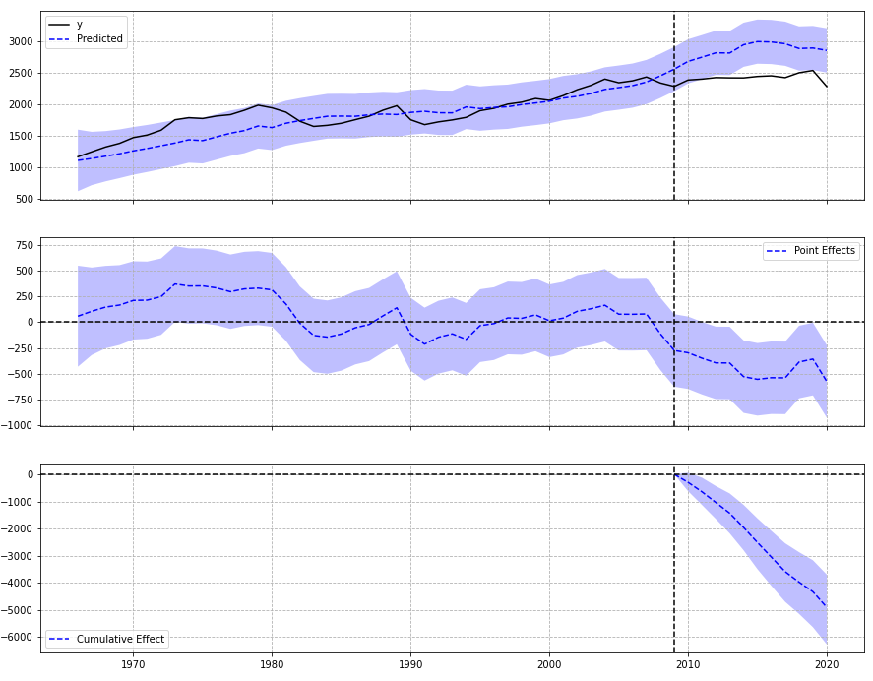
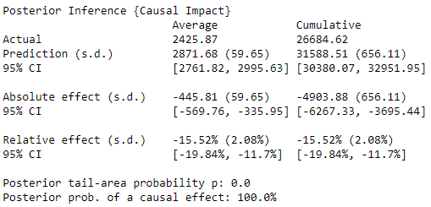
Synthetic Control: Oil Consumption
Saudi Arabia
Pre-period: 1965-2009 (80%)
Post-period: 2010-2020 (20%)

Slide 26
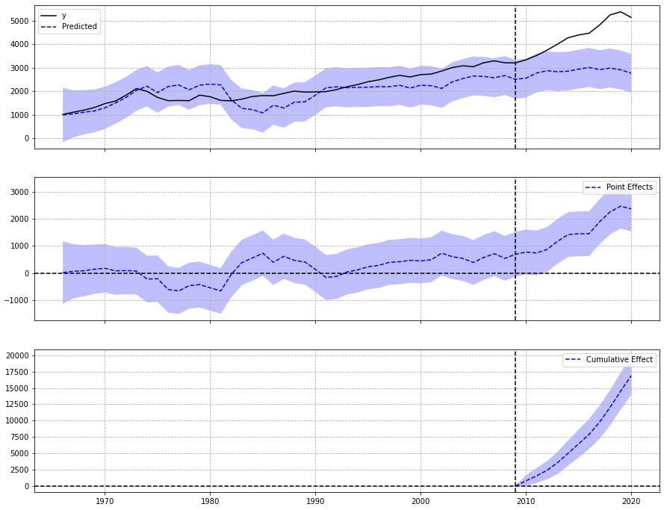
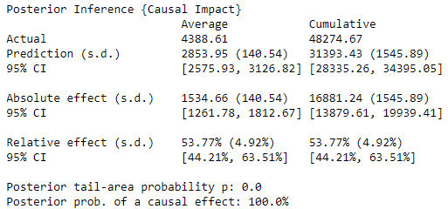
Synthetic Control: Oil Production
Saudi Arabia
Pre-period: 1965-2009 (80%)
Post-period: 2010-2020 (20%)

Slide 27
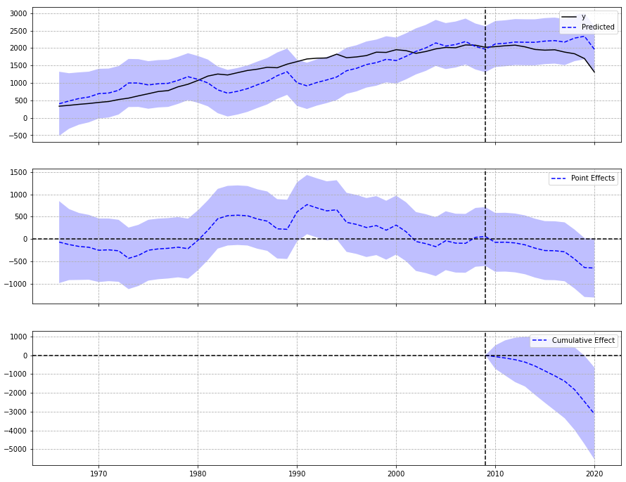
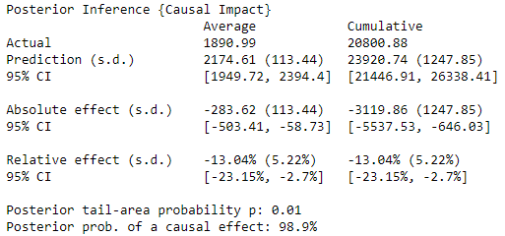
Synthetic Control: Oil Consumption
Canada
Pre-period: 1965-2009 (80%)
Post-period: 2010-2020 (20%)

Slide 28
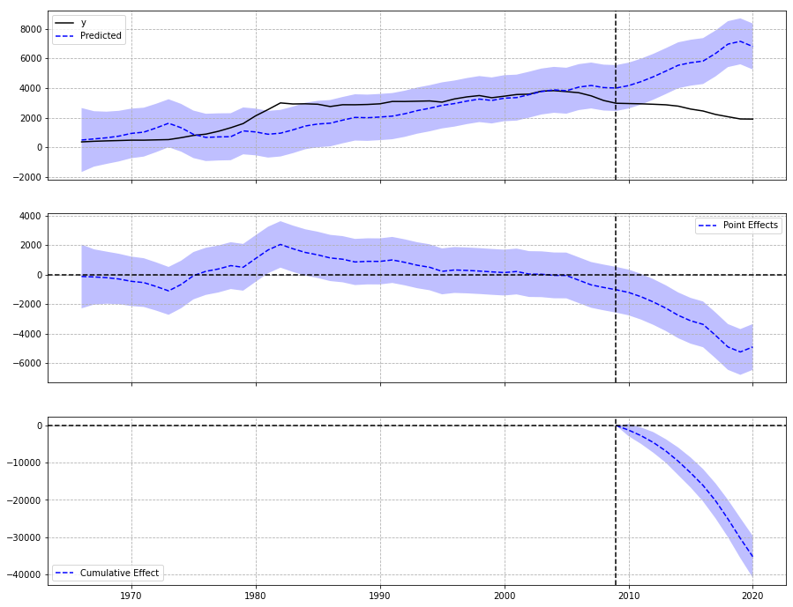
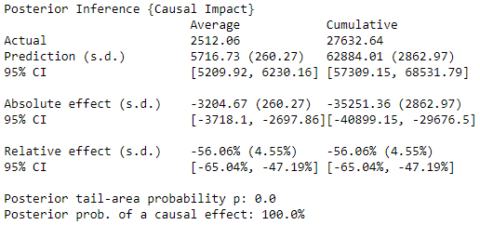
Synthetic Control: Oil Production
Canada
Pre-period: 1965-2009 (80%)
Post-period: 2010-2020 (20%)

Slide 29
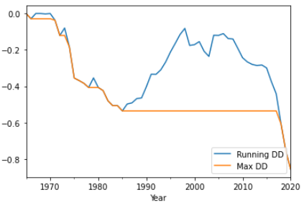
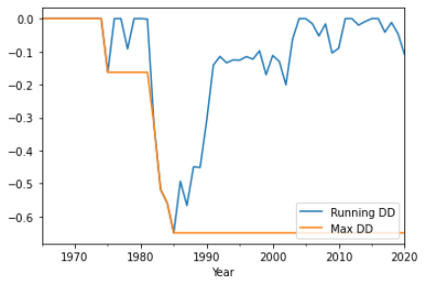
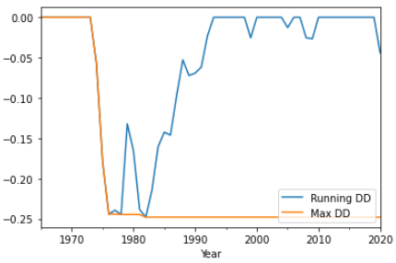
Max Drawdown: Oil Production
MDD is the maximum loss from a peak to a trough before a new peak is produced. One use of this is to measure a downside risk over a period of time
Venezuela
Saudi Arabia
Canada

Slide 30
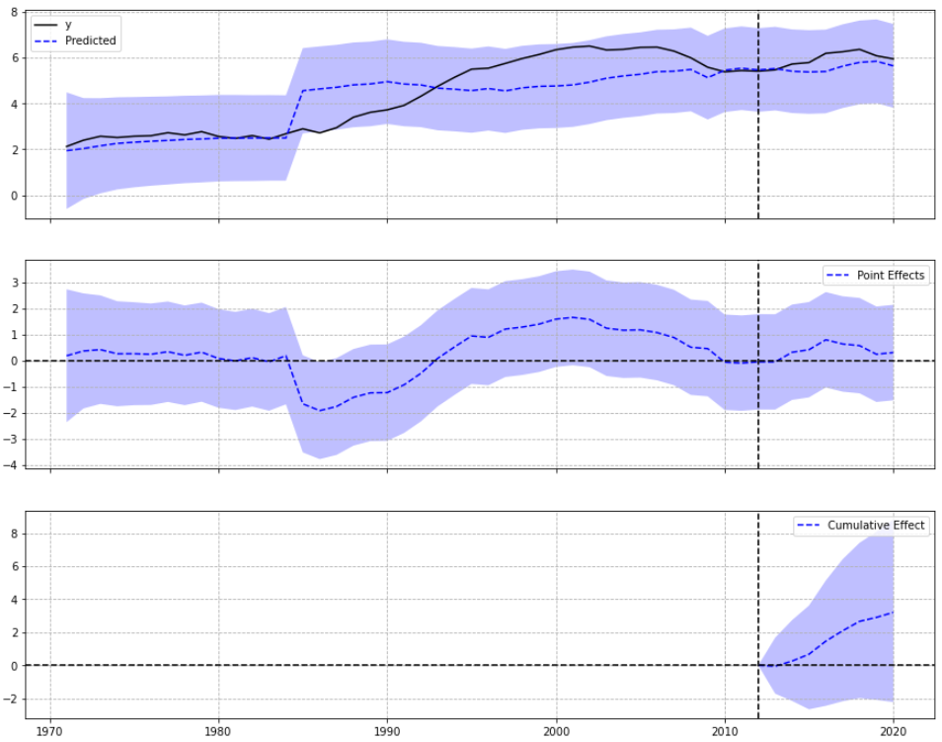
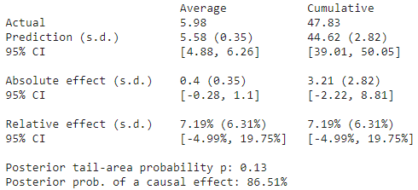
Synthetic Control: Gas Production
Russian Federation
Pre-period: 1970-2012 (84%)
Post-period: 2013-2020 (16%)

Slide 31
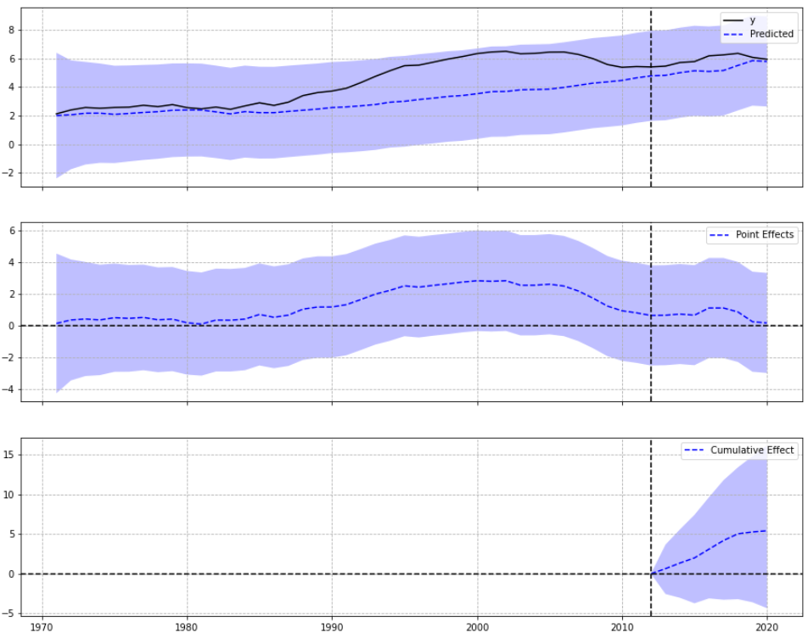
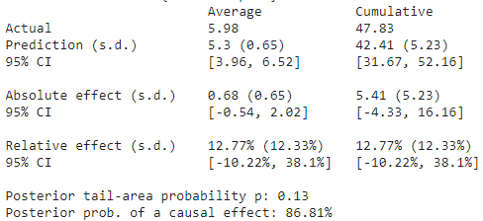
Synthetic Control: Gas Production
U.S.
Pre-period: 1970-2012 (84%)
Post-period: 2013-2020 (16%)

Slide 32
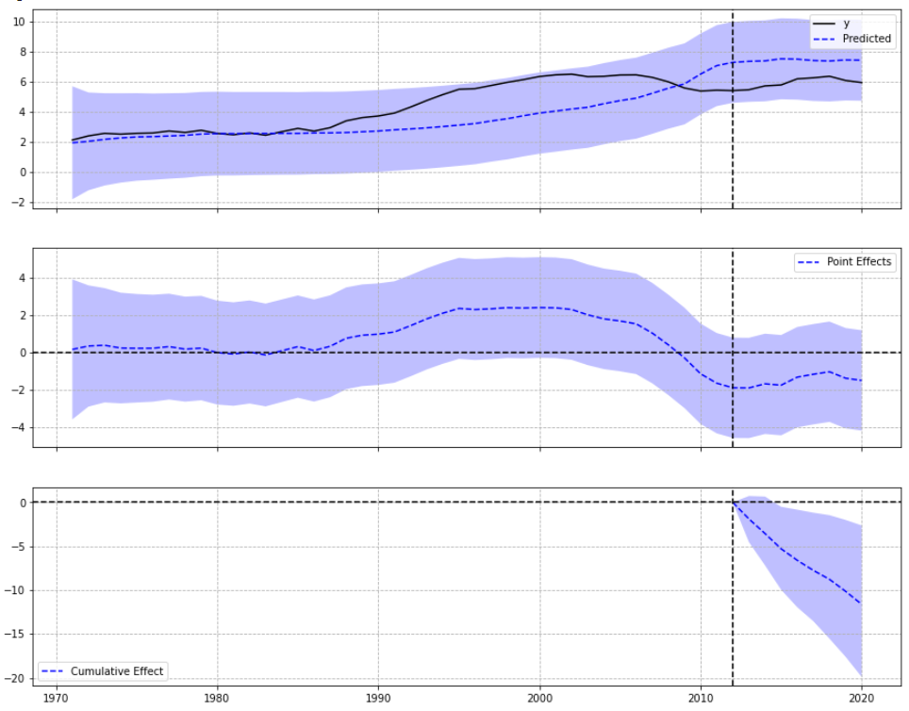
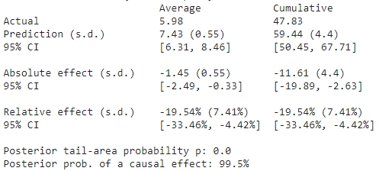
Synthetic Control: Gas Production
Qatar
Pre-period: 1970-2012 (84%)
Post-period: 2013-2020 (16%)

Slide 33
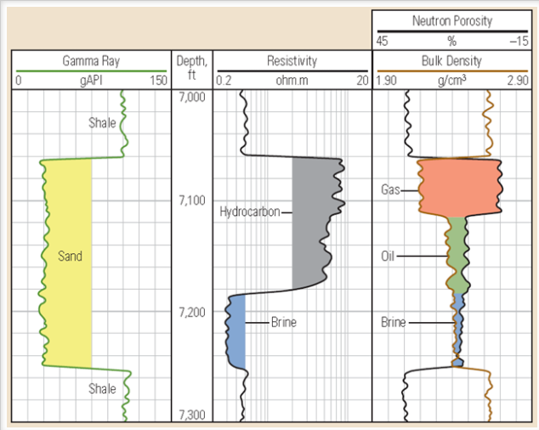
Well Log Analysis: Athabasca Oil Sands (Part 1)
Source: Athabasca Oil Sands Data McMurray/Wabiskaw Oil Sands Deposit - Electronic Data | Alberta Geological Survey (aer.ca)
Original file: 2,173 logs
Analyzed: 87 logs (no nulls)
Use Ko Ko Rules to analyze well logs:
Plot triple combo logs sequentially: GR, Resistivity, Density-Neutron.
Plot GR in the first track and Resistivity in the second track.
Both curves should be plotted in increasing values from the left to the right.
Plot Density-Neutron together on the same track.
The values should be decreasing as we go from the left to the right.

Slide 34
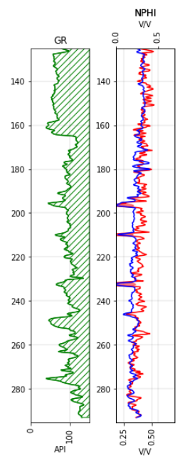
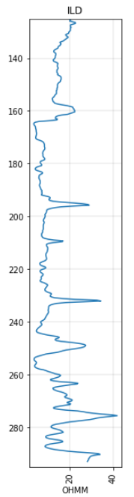
Well Log Analysis: Athabasca Oil Sands (Part 2)
Use Ko Ko Rules to analyze well logs:
Tight non-reservoir: Right-Right-Right-Right
Shale: Right-Right-Right-Left
Low porosity reservoir: Left-Right-Right-Right
Water-bearing reservoir: Left-Left-Left-Left
Oil-bearing reservoir: Left-Right-Left-Left
Gas-bearing reservoir: Left-Right-Left-Right
Goal: Create learning models to reduce the uncertainty and risk for drilling a dry well.

Slide 35
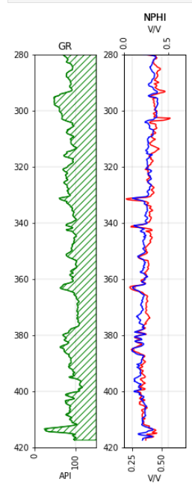
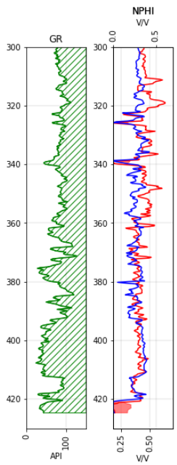
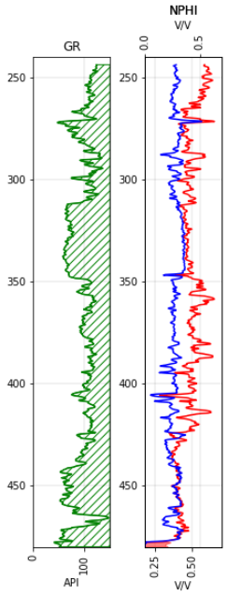
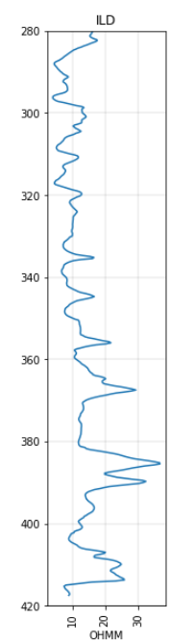


No
Yes
Yes

Slide 36


Feature Engineering
OneHot Encoding
Train and test split

Slide 37


Classification Models
GradientBoost

Slide 38


Classification Models: Pycaret

Slide 39


Create model: Naïve Bayes and Random Forest

